Slide 1
NFL Draft Application
Storyboard
Bibata Rabba Idi
01/21/2018
CST-105
Professor Mohamed Mneimneh

Slide 2


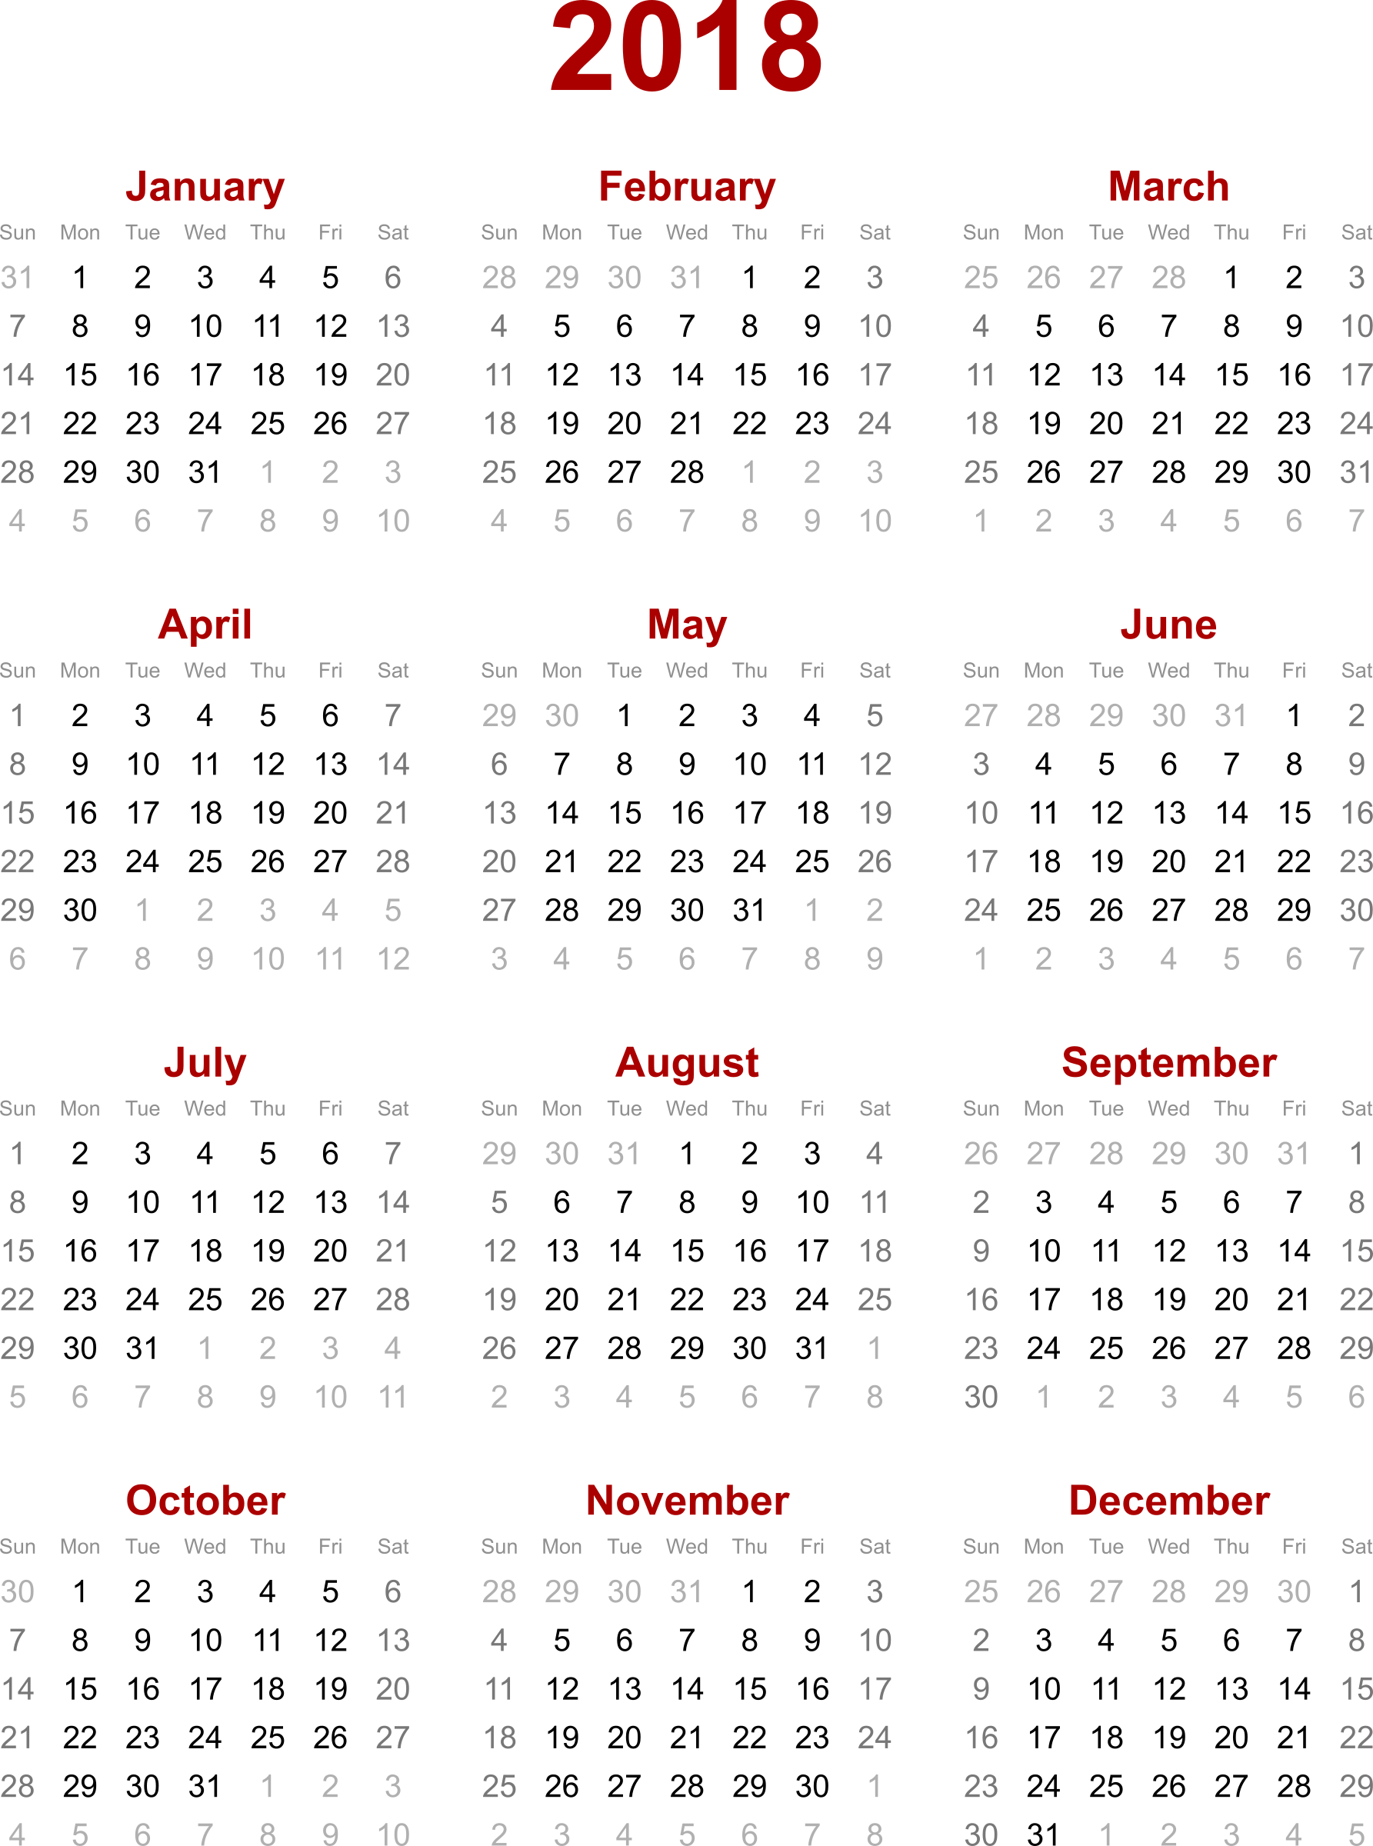
User Name
User Info
Home
Players List
Drafted Players
Not Drafted Players
Stats
Player’s Team
Roster
This is the home page, it has an NFL logo, 7 tabs that will represent class and child-classes. For example “Drafted Players” and “Not Drafted Players” could be child-classes of the “Players” class. Each of the seven tabs will be updated by the CEO. These four tabs(Players List, Stats, Player’s Team and Roster will all lead to four different screens by pressing them. Drafted Players and Not Drafted Players tabs will only show a list of corresponding players and the home tab will be the way it is now when pressed.

Slide 3
Players team
Order
Sort By
Arizona Cardinals
Atlanta Falcons
Baltimore Ravens
Bullafo Bills
Carolina Panthers
Chicago Bears
Choose
The players screen will be improved and will include more characteristics (defensive and offensive classes for example), the radio button will indicate whether a player has been drafted or not. The scrollbar will be used to look for players according to the search engine the information is sorted by( for example: player’s first or last name, age, …). At the end all the selected players will be chosen.

Slide 4
Active Roster
 | # | Name | Pos. | Ht. | Wt. | Age | Exp. | College
 | 19 | Agudosi, Carlton | WR | 6-6 | 220 | 24 | R | Rutgers
 | 54 | Albright, Bryson | OLB | 6-5 | 235 | 23 | 1 | Miami (Ohio)
 |  | Allen, Josh | C | 6-3 | 315 | 26 | 1 | Louisiana-Monroe
 | 63 | Anau, Peli | DT | 6-3 | 282 | 24 | R | Northern Arizona
 | 36 | Baker, Budda | S | 5-10 | 195 | 22 | R | Washington
 | 9 | Barkley, Matt | QB | 6-2 | 227 | 27 | 4 | USC
 | 64 | Barnes, Khalif | T | 6-6 | 320 | 35 | 12 | Washington
 | 41 | Bethea, Antoine | S | 5-11 | 206 | 33 | 11 | Howard
ADD
The player’s team, will be created by adding players. A checkbox next to the player will be checked if the player is chosen to be part of a team, if not, it will be unchecked. At the end, the ADD button will be pressed to update the team members. At anytime the CEO can go and uncheck the checkbox to remove a player from a team.

Slide 5
Stats Screen
Player’s Name
Sort By
The horizontal scrollbar will display the players, there are 5 stats for each player.
Tom Brady | Nick Foles | Drew Brees | Blake Bortles | Case Keenum | Ben Roethlisberger | Marcus Mariota | Matt Ryan
NE | PHI | NO | JAX | MIN | PIT | TEN | ATL
QB | QB | QB | QB | QB | QB | QB | QB
89 | 77 | 48 | 49 | 53 | 37 | 41 | 43
139 | 106 | 73 | 85 | 88 | 58 | 68 | 66
64.0 | 72.6 | 65.8 | 57.6 | 60.2 | 63.8 | 60.3 | 65.2

